Slide 1
HTM
Weekly Quality Update
WEEK 29, 2022

Slide 2
QUALITY – RFT (Inline Inspection)*
ITEM | B-GRADE | C-GRADE | REWORK | TOTAL DEFECT | QTY PRODUCE | % RFT | TARGET | TOP 2 DEFECTS
Cutting | - | 32 | - | 32 | 3,041 | 98.95% | 100% | Reject Material X-Ray
Sewing | - | 9 | 6 | 15 | 2,766 | 99.46% | 99.80% | Contamination Delamination
Assembling | 0 | 39 | 120 | 159 | 3,581 | 95.56% | 98.00% | Bubble Damage Lining
Finishing | - | - | - | - | 3,542 | 100.00% | 100%
Total RFT |  |  |  |  |  | 94.05% | 97.80%
ITEM | B-GRADE |  | C-GRADE |  | REWORK
 | Model | Pairs | Model | Pairs | Model | Pairs
Cutting | - |  | Chore | 32 | - | -
Sewing | - |  | Chore | 9 | Chore | 6
Assembling | ADB Chore | - - | ADB Chore | 23 16 | ADB Chore | 62 58
Finishing | - |  | - |  | - | -
* Excluded Technical Process

Slide 3
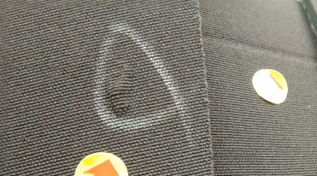
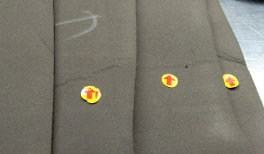
QUALITY – TOP 2 DEFECTS (CUTTING)
TOP 1 - ISSUE Reject Material
POTENTIAL ROOT CAUSE : Damage material lining
QTY Quality : 20 prs (0.66%)
TOP 2 - ISSUE X-Ray Lining
POTENTIAL ROOT CAUSE : Stacking lining over
QTY Quality : 12 prs (0.39%)
No | ACTION PLAN | PIC | DUE DATE
1 | Communication with Vendor about the issue, to replace and improvement on process | Anna ( purch ) | Jul 25
2 | Keep to ensure the lining with marking lining transfer to production line | Andre ( QC ) | Jul 25
No | ACTION PLAN | PIC | DUE DATE
1 | Communication with Vendor about the issue, to replace and improvement on process | Anna ( purch ) | Jul 25
2 | Keep to ensure the lining with marking lining transfer to production line | Andre ( QC ) | Jul 25

Slide 4
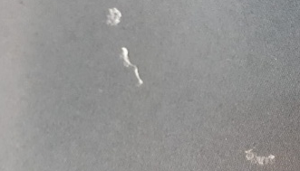
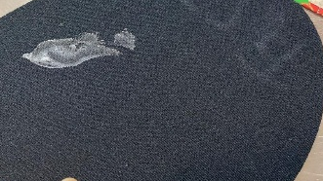
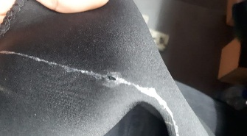
QUALITY – TOP 2 DEFECTS (Sewing)
TOP 1 - ISSUE Contamination
POTENTIAL ROOT CAUSE : Over Cementing
QTY Quality : 9 prs (0.39%)
TOP 2 - ISSUE Delamination
POTENTIAL ROOT CAUSE : UN-even cementing process
QTY Quality : 6 prs (0.26%)
No | ACTION PLAN | PIC | DUE DATE
1 | Keep to ensure cementing process is follow standard (must thin and even) | Yusron / Dede | Jul 25
2 | Keep to tighten control the lining storage process after the glue process do not overlap | Yusron / Dede / Paruntungan | Jul 25
No | ACTION PLAN | PIC | DUE DATE
1 | Keep to control cementing process is follow standard (must thin even). | Yusron / Dede | Jul 25
2 | Keep to ensure setting temperature chamber is follow standard, Regular checking chamber by LAB team. | Yusron / Dede | Jul 25

Slide 5
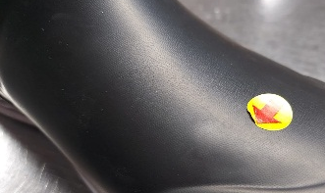
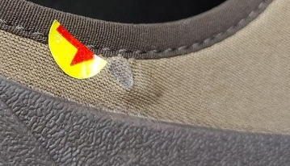
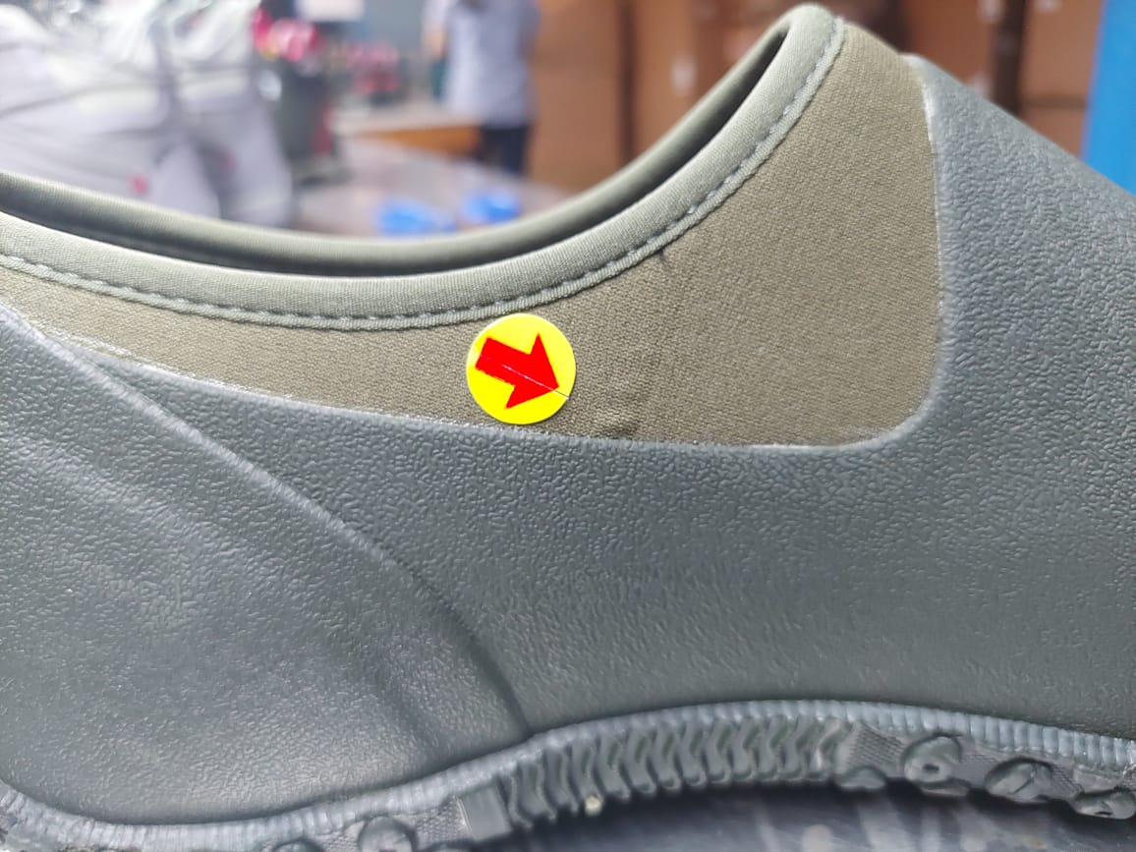
QUALITY – TOP 2 DEFECTS (ASSEMBLING)
TOP 1 – ISSUE Bubble
POTENTIAL ROOT CAUSE : Over Drying
QTY Quality : 10 prs ( 0.28%)
TOP 2 - ISSUE Damage Lining
POTENTIAL ROOT CAUSE : Damage material lining
QTY Quality : 6 prs (0.17%)
No | ACTION PLAN | PIC | DUE DATE
1 | Keep to control cementing process and distance between cementing and attaching rubber process follow standard (4 pcs after cementing to attaching rubber) | Hasanudin Andre | Jul 25
2 | Keep to ensure attaching rubber and hand pressing is follow standard | Hasanudin Andre | Jul 25
No | ACTION PLAN | PIC | DUE DATE
1 | Communication with Vendor about the issue, to replace and improvement on process | Hasanudin Andre | Jul 25
2 | Keep to ensure the lining with marking lining transfer to production line | Hasanudin Andre | Jul 25

Slide 6
QUALITY – %PASS RATE FINAL INSPECTION
Total PO | QTY Prs PO | QTY Inspect | Qty PO Passed | Qty Pairs Passed | Qty PO Re-Packing | QTY Prs Re-Packing | % PO Pass Rate FI | % Prs Pass Rate FI
24 | 19,174 | 14,626 | 24 | 19,174 | - | - | 100.0% | 100.0%
Detail PO Re-Inspection
No | PO | QTY PO | SKU’s | Dest | Defect Rejected PO | Qty Pass Re-Inspection | Defect Re-inspection | Others Defect | Pictures | Status

Slide 7
QUALITY – B & C Grade
 | 2021 | JAN ’22 | FEB ’22 | MAR ’22 | APR ’22 | MAY ’22 | JUN ’22 | JUL ’22 | AGS ’22 | SEP ’22 | OCT ’22 | NOV’ ’22 | DEC’ ’22 | TOTAL 2022
TTL PRODUCE | 1,422,064 | 151,957 | 155,568 | 169,606 | 98,174 | 44,835 | 60,569 | 32,201 |  |  |  |  |  | 712,910
B-GRADE | 1,035 0.07% | 357 0.23% | 383 0.25% | 262 0.15% | 236 0.24% | 160 0.36% | 102 0.17 % | 0 0 % |  |  |  |  |  | 1,526 0.21 %
C-GRADE | 20,740 1.46% | 1,108 0.73% | 696 0.45% | 1,013 0.60% | 754 0.76% | 405 0.90% | 397 0.66 % | 140 0.43 % |  |  |  |  |  | 4,663 0.65 %
B-GRADE | 2021 Jan – Dec ’21 | 2022 Jan - Apr
XT - WH | 8 | -
XT- ADB | 113 | 951
MUCK FAMILY | 914 | 553
C-GRADE | 2021 Jan – Dec ’21 | 2022 Jan - Apr
XT - WH | 887 | -
XT- ADB | 9,976 | 2,528
MUCK FAMILLY | 9,877 | 1,985

Slide 8




